Slide 1
DevOps for Large Monolithic Tightly Coupled Software Architectures
Richard F. Eng
reng@mitre.org
The author's affiliation with The MITRE Corporation is provided for identification purposes only, and is not intended to convey or imply MITRE''s concurrence with, or support for, the positions, opinions or viewpoints expressed by the author.

Slide 2
Outline
Background
DevOps
Preparing for DevOps
DevOps Capabilities
Large Monolithic Tightly Couple Software Applications
DevOps for Tightly Couple Architecture
Conclusions

Slide 3
Background

Slide 4
Background
Software literature provides examples of the successful use of DevOps to improve the software deployment pipeline
Case studies based on
Small development teams
Loosely coupled software architectures
Web-based applications
Implemented on cloud computing platforms

Slide 5
Why Build Software Solutions?
To satisfy regulatory requirements
To support business requirements
To gain competitive advantage

Slide 6
Challenge
Rapidly deploying trusted functioning software solutions
Achieving DevOps benefits when the application is a large, monolithic, tightly coupled software architecture

Slide 7
DevOps

Slide 8
DevOps
Development and Operations (DevOps)
A philosophy for teams to collaborate to deploy trusted functioning software solutions
Eliminate inefficiencies in the deployment process
Focus on competency over process

Slide 9
Notional Deployment Pipeline
Business Idea
Development
Test & Integration
Acceptance & Pre-Production Tests
Operations & Maintenance
Observe and fix what really matters
Observe the time it takes for a business idea to be deployed into production

Slide 10
DevOps is Multiple Pipelines
Business Idea
Development
Test & Integration
Acceptance & Pre-Production Tests
Operations & Maintenance
Application
Code, Test, Security & Privacy, etc.
Environment
Settings, Version Control System, OS, Tools, Monitoring, etc.
Infrastructure
Cloud, Data Center, Servers, Storage, etc.

Slide 11
DevOps “Everything” Mantra
Shift everything to the left of operations and maintenance
Automate everything
Test everything
Observe everything

Slide 12
Common Misconceptions
No cultural change
DevOps is all about tools & automation
DevOps improves the deployment pipeline
Code as infrastructure is the solution
Application architecture remains the same
DevOps metrics makes deployment faster

Slide 13
Indicators of Not Quite DevOps
Never implemented an Agile project
Optimize a sub-process rather than whole deployment pipeline
Metrics have no impact on improving efficiency
Lack repeatable baseline testing (e.g., infra, environ, dev)
Single CI/CD pipeline
Tickets required to get things done
Dependence on executive decision making
Meetings with no impact on deployment
Separate DevOps team
Code repository has one branch
Automated tools exist, but not used
Still use manual processes
Can collect metrics, but don’t
Not Quite DevOps
Continuous Integration/Continuous Delivery (CI/CD)

Slide 14
Preparing for DevOps

Slide 15
Deployment Pipeline Considerations
How long does it take to go from a business idea to production?
Optimize DP processes before trying to implement DevOps
If it takes 12 to 18 months to get an authority to operate, fix the bottleneck
If it takes six months to go from development to completion of testing, fix that bottleneck

Slide 16
Experiment
Observe how long it takes to deploy a “Hello World” application
Observe how long it takes to deploy a change to “Hello World” application
Map out the deployment pipeline
Document and remove the inefficiencies

Slide 17
DevOps is Multiple Pipelines
Business Idea
Development
Test & Integration
Acceptance & Pre-Production Tests
Operations & Maintenance
Application
Code, Test, Security & Privacy, etc.
Environment
Settings, Version Control System, OS, Tools, Monitoring, etc.
Infrastructure
Cloud, Data Center, Servers, Storage, etc.

Slide 18
Ideal DevOps Organizational Traits
Effective collaboration, higher level of trust
Mission emphasized, personal issues put aside
Hierarchy play less of a role

Slide 19
DevOps Capabilities

Slide 20
DevOps Capabilities Checklist
Cultural Capabilities
Technical Capabilities
Process Capabilities
Measurement Capabilities

Slide 21
Cultural Capabilities
Westerum Organizational Model - Generative
Climate for Learning
Collaboration
Job Satisfaction

Slide 22
Westerum Organizational Model
Pathological | Bureaucratic | Generative
Power-oriented | Rule-oriented | Performance-oriented
Low co-operation | Modest co-operation | High co-operation
Messengers shot | Messengers neglected | Messengers trained
Responsibilities shirked | Narrow responsibilities | Risks are shared
Bridging discouraged | Bridging tolerated | Bridging encouraged
Failure leads to scapegoating | Failure leads to justice | Failure leads to inquiry
Novelty crushed | Novelty leads to problems | Novelty implemented

Slide 23
Technical Capabilities
Version Control
Deployment Automation
Continuous Integration
Trunk Based Development
Test Automation
Decoupled Architecture
Test Data Management
Security and Privacy

Slide 24
Process Capabilities
Customer Value
Value Stream Mapping
Small Batches
Change Approval Process

Slide 25
Measurement Capabilities
Measurements and Metrics
Failure Notification
Work in Progress Limits
Visualization of Work
Feedback to Stakeholders

Slide 26
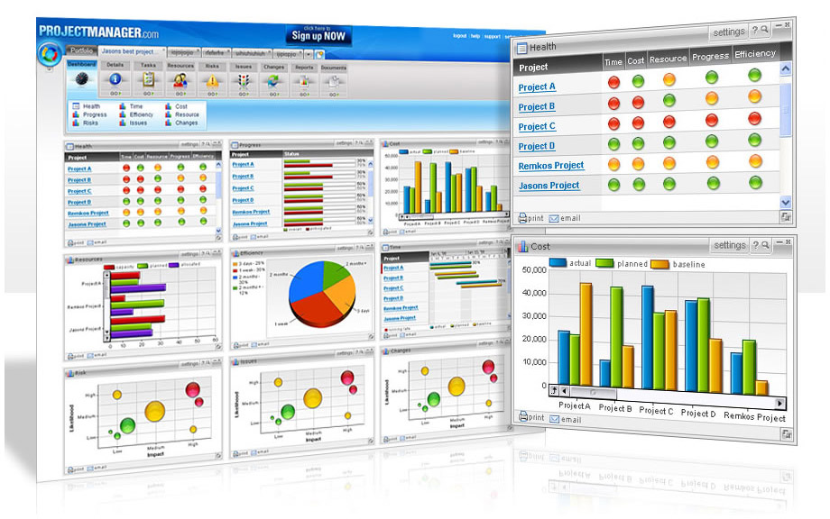
Notional Deployment Pipeline with Measurement & Feedback
Defect Data Collection
Business Idea
Development
Test & Integration
Acceptance & Pre-Production Tests
Operations & Maintenance
Defects & Measurements
Feedback
Defects & Measurements
Fix
Defect Decision
Defect Analysis
Accept/Defer
Defect
Database
Root cause analysis
Cluster analysis
Aging analysis
Etc.
Defect Metrics
& Reporting
Minimum viable product
Time to remediate
Defect Severity
Defect Priority
Etc.

Slide 27
DevOps Baseline Measures

Slide 28
DevOps Baseline Measures
Requirements baseline
Environment baseline
Testing baseline
Security and privacy baseline

Slide 29
Requirements
Percentage of organizations capacity spent on documenting requirements and planning
Amount of requirements inventory waiting for development in terms of days of supply
Percentage of the requirements reworked after originally defined
Percentages of delivered features used by the customers and are achieving the expected business results

Slide 30
Environment
Time from environment request to delivery
How frequently new environments are required
Percent of time environments need fixing
Percent of defects associated with code vs. environment vs. deployment vs. database vs. other at each stage in the DP

Slide 31
Testing
Time it takes to run the full set of testing
Repeatability of the testing (false failures)
Percent of defects found with unit tests, automated system tests, and manual tests
Time it takes the release branch to meet production quality
Approval times
Batch sizes or release frequency at each stage

Slide 32
Security & Privacy Assessments
Percentage of resources spent on documenting security and privacy requirements and planning
Time it takes to prepare for security and privacy control assessment in terms of days of supply
Time to remediate security and privacy deficiencies after discovery in terms of days
Number of security and privacy deficiencies remediated

Slide 33
Production Release
Time and effort to deploy and release to production
Number of issues found during release and their source (e.g., environment, development, deployment, test, data)

Slide 34
Operations and Observation
Issues found in production
Time to restore service

Slide 35
Scaling to Continuous Integration
Number of green builds a day and the percent green in continuous integration
Time to recover from a red build
Percent of features requiring rework before acceptance by the business
Amount of effort required to integrate code from different developers to complete a working feature

Slide 36
Large Tightly Coupled Monolithic Software Architectures

Slide 37
Monolithic Tightly Coupled Software Architectures
Single unit
Built in three main parts:
Client-side user interface
Database
Server-side monolithic application
Tightly coupled software
Multiple software features imbedded in a software an application
Many number of lines of code to decipher
Complex to decipher
Might be difficult to coordinate large teams

Slide 38
Monolithic Tightly Coupled Software Architectures(cont.)
Takes time to:
Understand the code
Test the code
Debug the code
Must retest entire application when changes are made

Slide 39
What’s Old is New Again
Make applications smaller and easier to understand and create
Functions
Procedures
Methods
Code libraries
Service Oriented Architecture (SOA)
Breaking up applications into smaller software components

Slide 40
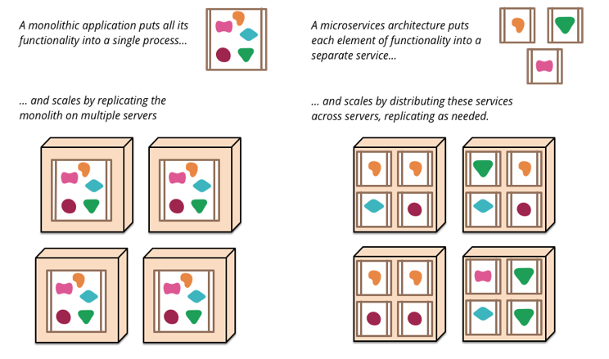
Monolithic versus Microservices
Source: https://martinfowler.com/articles/microservices.html

Slide 41
Conway’s Law
Any organization that designs a system (defined broadly) will produce a design whose structure is a copy of the organization's communication structure.
Melvyn Conway, 1967

Slide 42
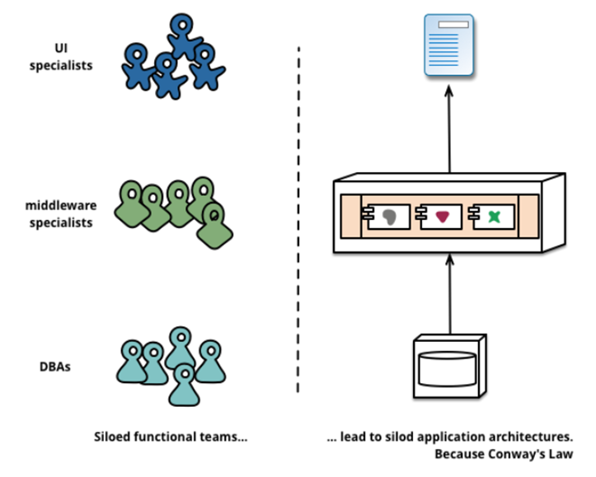
Silos
Source: https://opensource.com/resources/what-are-microservices

Slide 43
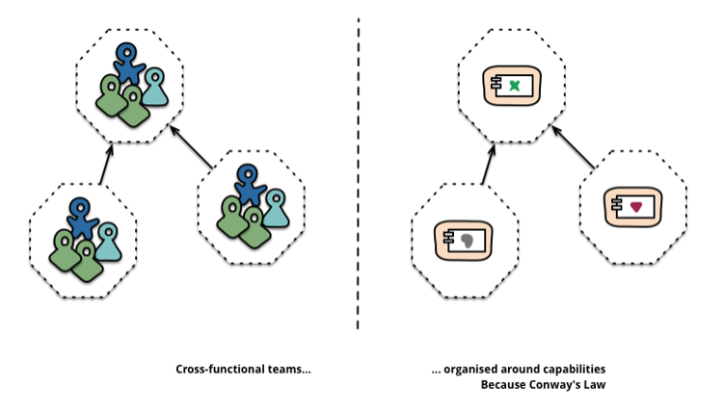
Cross-functional
Source: https://opensource.com/resources/what-are-microservices

Slide 44
Architectural Style
Microservice architectural style
Services are software components
Developing a single application as a suite of small services
Each application running in its own process
Each application is communicating with lightweight mechanisms often as HTTP resource API
Makes it possible to and replace services without impacting other services – in theory anyway

Slide 45
Architectural Style (cont.)
Services are
Built around business capabilities
Independently deployable by fully automated deployment machinery
Minimum of centralized management of these services
Services may be written in different programming languages
Each service may use different data storage technologies

Slide 46
Central Ideas for Microservices
SOA on steroids
Build loosely coupled software services/components along business lines
Smaller software services are easier to:
Understand
Create
Test
Debug
Replace

Slide 47
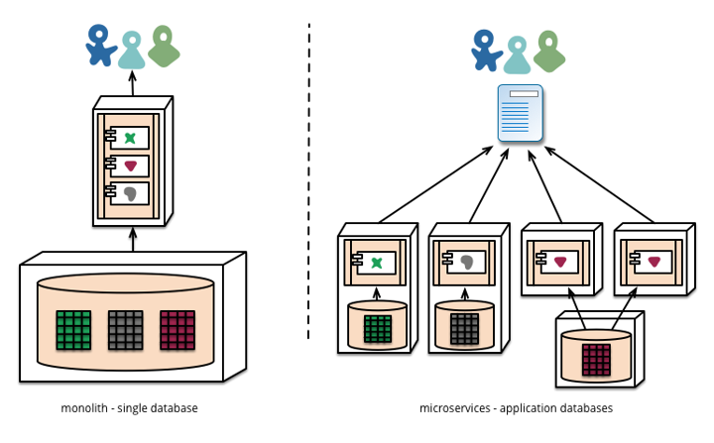
Central Ideas for Microservices (cont.)
Services manage their data
Teams own the software throughout the lifecycle

Slide 48
Characteristics of Microservices
Decouple the software components
Orchestrate software components
Software modules are accessed via message service (orchestration) and API (end point)
Minimize dependencies that cause the system to fail if
Timing issues or resources are unavailable
Protect against cascade failures from one component to the next
Replace software components without impacting other components
Small development teams work faster
Two person pizza rule

Slide 49
Characteristics of Microservices (cont.)
Rather than spending time debugging a component, replace the component quickly - in under five minutes
Reuse software components
Tailor software components for similar services or features
Scale to match demand
Add more instances to handle the additional load, scale down when demand is low
Platform as a Service provides the abstraction layer to manage, monitor, & scale

Slide 50
Characteristics of Microservices (cont.)
Microservice applications need to be managed, observed/monitored and scaled
Platform as a Service provides the abstraction layer to manage, monitor, and scale
Reliability and availability from ability to manage, observe/monitor, & scale the application
Each service has its own process resource
Provision new instances to scale and maintain performance, reliability, and availability

Slide 51
DevOps for Tightly Coupled Architectures

Slide 52
Segment Application Architecture
Segment tightly coupled monolithic application architecture into
Business essential
Non-business essential
Identify business essential components that can be decoupled from the monolithic architecture
Make each decoupled component a deployment pipeline
Empower the team to optimize their deployment pipeline
Empower small teams to own rearchitecting

Slide 53
Segment Application Architecture (cont.)
Integrate the loosely coupled applications with the monolithic application
Iterate the process of segmenting the monolithic application until there is no business value to continue
Examine remaining tightly coupled monolithic application
Identify simple architectural changes to decouple the application further
Treat each new component as its own deployment pipeline

Slide 54
Tackling Remaining Tightly Coupled Application
Continue until there is no value to decoupling the monolithic application further
Rearchitect and replace the remaining monolithic application in the future

Slide 55
Conclusion

Slide 56
DevOps Success
Depends on:
Empowered collaborative teams
Loosely coupled software architecture
Ability to self provision environments
Anyone can push functioning code into production
Focus on delivering functioning trusted solutions that have business value

Slide 57

Questions

Slide 58
References

Slide 59
References
B. Beyer, C. Jones, J. Petoff, and N. Murphy, Site Reliability Engineering: How Google Runs Production Systems, O’Reilly Media, Inc., 2016.
G. Dawson, A roadmap for IT Modernization, IBM Center for The Business of Government, 2018. Retrieved from: http://www.cio.nebraska.gov/news/docs/pdf/A_Roadmap_for_IT_Modernization_in_Government.pdf
A. Demarco, V. Iancu, and I. Asinofsky, COBOL to Java and Newspapers Still Get Delivered, IEEE Computer Society, 2018. Retrieved from: https://ieeexplore.ieee.org/stamp/stamp.jsp?tp=&arnumber=8530069&tag=1

Slide 60
References (cont.)
G. Gruver, Starting and Scaling DevOps in the Enterprise, BookBaby, 2016.
H. Huijgens, A. van Deursen, and R. van Solingen, Success Factors in Managing Legacy System Evolution: A Case Study, 2016 IEEE/ACM International Conference on Software and System Processes, 2016. Retrieved from: https://ieeexplore.ieee.org/document/783158
G. Kim, J. Humble, P. Debois, and J. Willis, The DevOps Handbook: How to Create World-Class Agility, Reliability, & Security in Technology Organizations, Oregon, IT Revolution, 2016.
H. Knoche and W. Hasselbring, Focus: Microservices Using Microservices for Legacy Software Modernization, IEEE Software May/June 2018. Retrieved from: https://ieeexplore.ieee.org/document/8354422

Slide 61
References (cont.)
K. Kuusinen, V. Balakumar, S. C. Jepsen, et. al., A Large Agile Organization on Its Journey Towards DevOps, 44th Euromicro Conference on Software Engineering and Advanced Applications, 2018. Retrieved from: https://ieeexplore.ieee.org/document/8498186
S. Newman, Building Microservice: Designing Fine-Grained System, O’Reilly Media, Inc., 2015.
M. T. Nygard, Release It!: Design and Deploy Production - Ready Software, The Pragmatic Programmer, 2018.
B. Ott, J. Pham, and H. Saker, Enterprise DevOps Playbook, O’Reilly Media, Inc., 2016.

